Slide 1

Interactive Music Genre Exploration with Visualization and Mood Control
AUTHORS
Yu Liang
Martijn C. Willemsen
Jheronimus Academy of Data Science
Eindhoven University of Technology
PRESENTED BY
Arihant Dugar
Abhinav Acharya Tirumala Vinjamuri
B00917961
B00929073
ar968345@dal.ca
ab806657@dal.ca

Slide 2

INTRODUCTION
Recommender Systems:
Purpose
Types (Personalized, Non-personalized, and Mixed)
Filter bubble issue
Limitations of existing systems
Visualizations:
Bar chart
Complex Contour plot
Mood Control:
Why is mood important?
Importance of mood control
1
CSCI 6612 Seminar Presentation

Slide 3
PROBLEMS ADDRESSED
RQ1: How do different types of visualization (bar charts or contour plots) influence the perceived helpfulness for new music genre exploration?
RQ2: How does mood control improve the perceived helpfulness for new music genre exploration?
2
CSCI 6612 Seminar Presentation

Slide 4
RELEVANCE
 | Research Paper | Our Project
Focus | Recommendations | Recommendations & Analysis
Dataset | Spotify Music Dataset | Spotify Music Dataset
Solution | Understand how visualization affects helpfulness for new music genre exploration | Interactive music-feature, genre exploration, and User matching.
Mood Control | Understand its influence on perceived helpfulness for new music genre exploration | To provide highest degree of interactivity to the user
3
CSCI 6612 Seminar Presentation

Slide 5
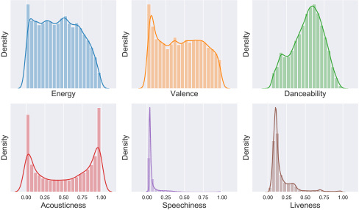
DATASET
Test Data : Data fetched from participants of the user study.
Train Data : Recommendation data has 10 music genres with 3300 tracks in each genre.
Spotify API.
Best Features:
Energy
Valence
Valence: positiveness of a track.
Energy: measures the intensity of tracks
4
CSCI 6612 Seminar Presentation

Slide 6

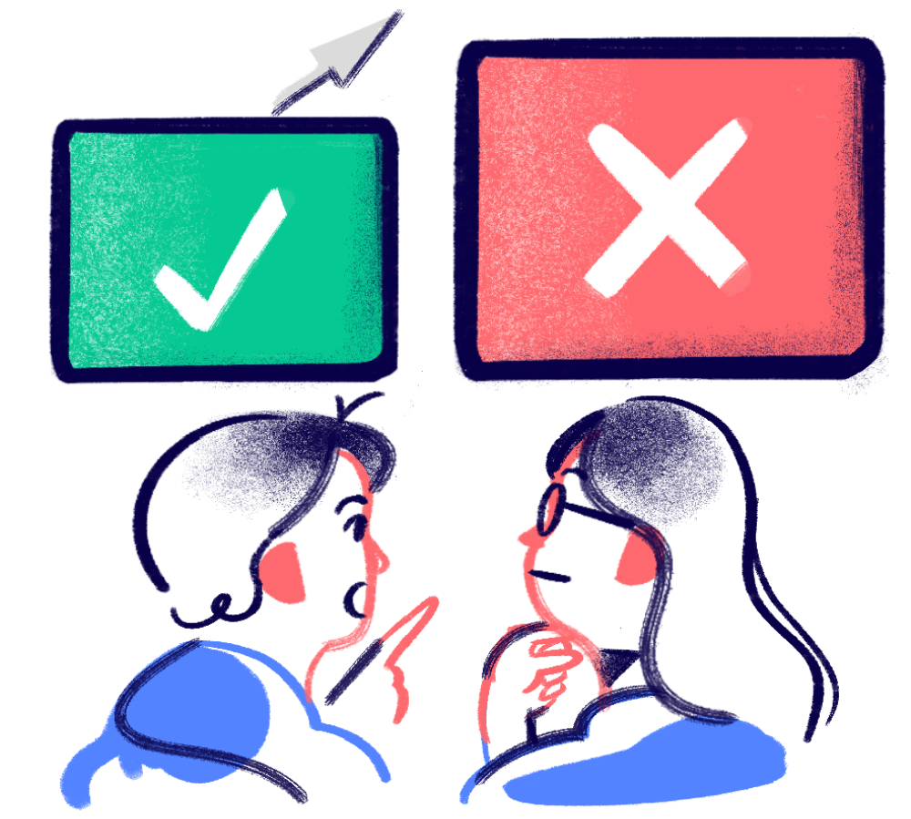



SOLUTIONS
Dashboard
User Study
Evaluation of study results
5
CSCI 6612 Seminar Presentation

Slide 7

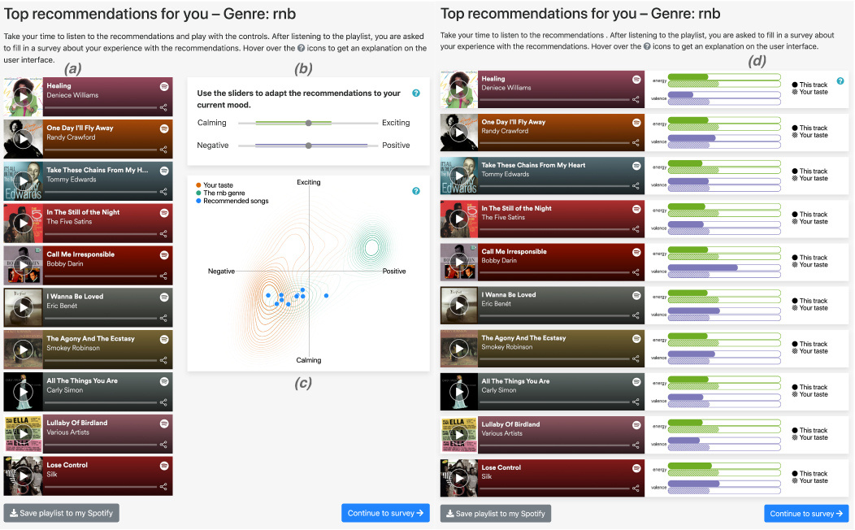
DASHBOARD
(a) Top 10 recommended songs presented in playlist style
(b) Two mood sliders for adjusting valence and energy
(c) Contour plot
(d) Bar charts
6
CSCI 6612 Seminar Presentation

Slide 8

USER STUDY
Study Design:
2x2 Mixed-Factorial design.
Variables/ Factors:
Mood Control (between-subjects factor)
Visualizations (within-subject factor)
Participants:
102 participants
Most from JF Schouten participant database of Eindhoven University of Technology and remaining from convenience sampling.
Mandatory Spotify account and no visual or hearing impairments.
Had to participate in Musical Sophistication Index Survey (MSIS).
Study Procedure:
Participants randomly assigned to conditions with or without mood control for genre exploration.
Two phases, each featuring a different visualization, and a questionnaire at the end.
System and Objective Measures:
System Subjective Aspects (SSA) from questionnaires.
User Interactive Behaviors (INT) from interactivity.
Musical Sophistication on Active Engagement (MSAE) and Musical Sophistication on Emotional Engagement (MSE) from MSIS.
7
CSCI 6612 Seminar Presentation

Slide 9
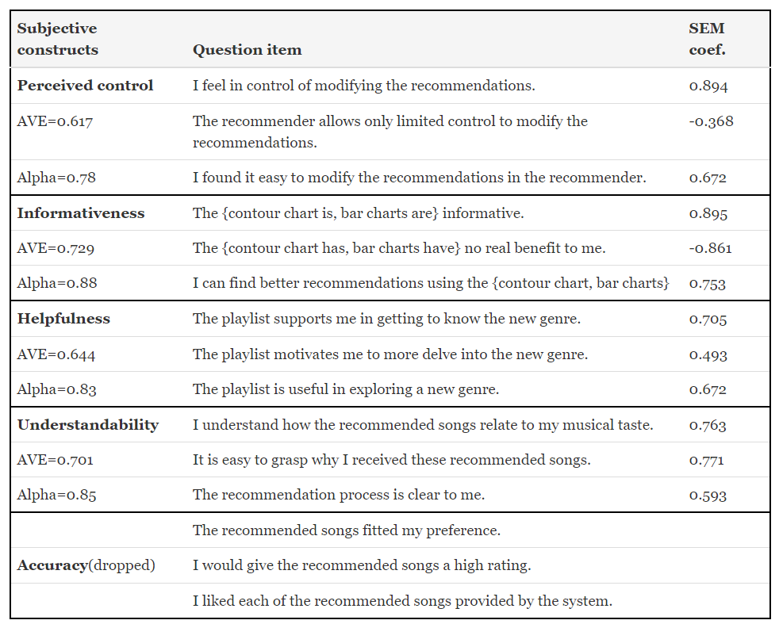
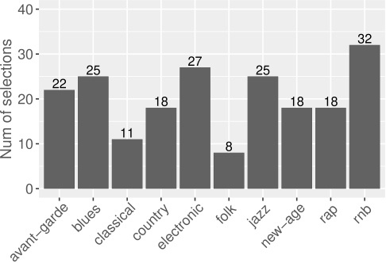
USER STUDY - DESCRIPTIVE STATISTICS
8
CSCI 6612 Seminar Presentation

Slide 10

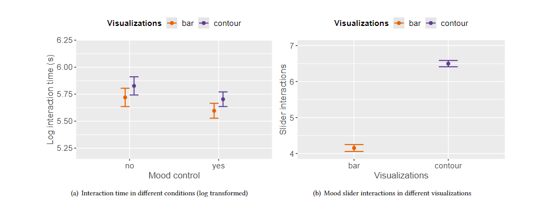
EVALUATION OF USER STUDY - INTERACTION DATA
Different Conditions:
Log Interaction Time
Track Interactions
Slider Interactions in the mood control conditions
Playlist saved or not
INSIGHTS:
Users interacted with the system shorter in the second phase.
Users interacted with the system longer with the contour plot than the bar chart.
Users interacted with the recommended tracks slightly less in the second phase than in the first phase.
Users used the slider much more with the contour plot than with the bar charts.
Users saved the playlist 14.2% of the time regardless of the conditions or the experimental phase.
9
CSCI 6612 Seminar Presentation

Slide 11
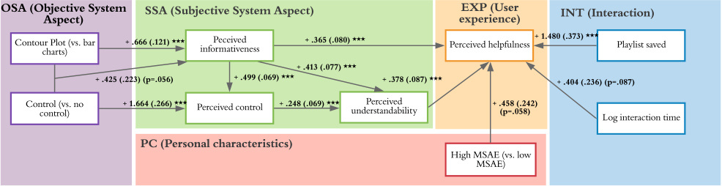
EVALUATION OF USER STUDY - SEM
SEM - Structure Equation Model
Important Components:
Perceived Informativeness
Perceived Control
Perceived Understandability
Perceived Helpfulness
MSAE - Musical Sophistication on Active Engagement
10
CSCI 6612 Seminar Presentation

Slide 12
LIMITATIONS
Non-generalizable results
Complexity of contour plots
Information loss in song features
Limited visualization techniques
Limited set of genres to recommend
Study only measured the short-term effects of the interactions and experiences of the users.
11
CSCI 6612 Seminar Presentation

Slide 13
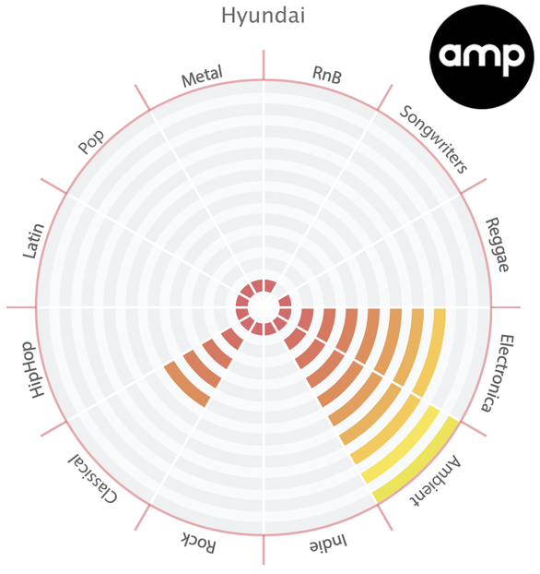
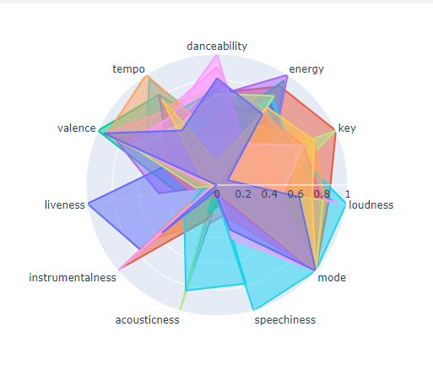
FUTURE WORKS
Diverse participants.
Diverse visualization techniques:
Radar charts,
Polar area charts
etc.
Extending the mood control to other dimensions or categories.
Integrating user feedback and adaptation mechanisms.
12
CSCI 6612 Seminar Presentaion

Slide 14

Thank you
13
CSCI 6612 Seminar Presentation

Slide 15

APPENDIX
Recommendation Methods:
Personalized:
This method calculates a track’s recommendation score in each feature dimension using a Gaussian mixture model. The tracks with the highest scores, averaged over all feature dimensions, are returned as the recommendations.
Non-Personalized:
This method calculates recommendation scores based on the prototypical tastes of the genre.
Mixed:
This method provides recommendation by combining scores of the two above algorithms.
Filter Bubble Issue:
The "filter bubble" refers to the isolation of individuals within personalized information ecosystems, limiting exposure to diverse content and viewpoints based on their preferences, potentially reinforcing biases and restricting the discovery of new information.
14
CSCI 6612 Seminar Presentation

Slide 16
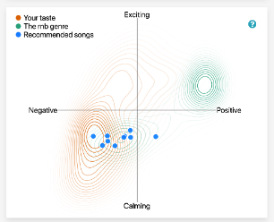
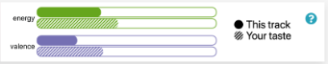
APPENDIX
Audio Features:
Energy: measures the intensity of tracks
Valence: positiveness of a track.
Danceability: How suitable a track is for dancing based on tempo, rhythm, and beat strength.
Acousticness: The likelihood of music being acoustic (without electric amplification).
Speechiness: The presence of spoken words or vocal content in the music.
Liveness: The perception of whether the music was recorded live or in a studio setting
Graph Types:
Complex Contour Plot : is a combination of one scatter plot with two contour plots
Bar Chart
15
CSCI 6612 Seminar Presentation

Slide 17
APPENDIX
Expectations:
Investigate the influence of two visualizations and mood control on perceived helpfulness for new music genre exploration.
Measure user’s perceived informativeness, control over the system, and understandability of recommendations.
Expect the contour plot to be more helpful than the bar chart due to its ability to visualize relations between the new genre, recommended songs, and current preferences.
Anticipate increased informativeness to improve user understanding of recommendations and perceived helpfulness for exploring new genres.
Acknowledge that contour plots might be complex for some users, potentially affecting their perceived informativeness.
Anticipate the addition of mood control to increase helpfulness for new genre exploration by enhancing controllability and understanding of recommendations.
Examine the effectiveness of mood control in both visualizations, expecting it to be more beneficial when combined with the contour plot.
Expect a positive interaction effect between contour plot and mood control on user perceptions, indicating greater effectiveness when combined.
Anticipate users to interact differently with the system based on the visualization type, potentially utilizing sliders more with the contour plot.
16
CSCI 6612 Seminar Presentation

Slide 18
APPENDIX
CONSTRUCTS:
Perceived control: This construct measures how much users feel in control of modifying the recommendations. It was derived from Pu et al. [1], who used three items to assess the perceived control of a recommender system.
Perceived informativeness: This construct measures how informative users find the visualization of the recommendations. It was constructed by the authors of this paper, who used three items to assess the perceived informativeness of the contour plot or the bar charts.
Perceived accuracy: This construct measures how accurate users find the recommendations. It was derived from Knijnenburg et al. [2], who used three items to assess the perceived accuracy of a recommender system.
Perceived understandability: This construct measures how easy users find it to understand the recommendations and the recommendation process. It was constructed by the authors of this paper, who used three items to assess the perceived understandability of the recommendations.
Perceived helpfulness: This construct measures how helpful users find the recommendations for exploring a new music genre. It was derived from Liang et al. [3], who used three items to assess the perceived helpfulness of a music genre exploration tool.
User interaction time: This is an objective measure of how long users interacted with the system in each phase. It was measured by logging the time users spent on the recommendation page.
Track interactions: This is an objective measure of how many tracks users listened to or hovered over in each phase. It was measured by logging the user actions on the recommended tracks.
Slider interactions: This is an objective measure of how many times users used the mood control sliders in each phase. It was measured by logging the user actions on the sliders.
Playlist saving behavior: This is an objective measure of whether users saved the playlist to their Spotify profile in each phase. It was measured by logging the user actions on the save button.
Musical sophistication: This is a personal characteristic of users that measures their musical expertise in active engagement and emotional engagement. It was measured by using the Goldsmith Musical Sophistication Index [4], which is a survey of 18 items.
17
CSCI 6612 Seminar Presentation

Slide 19
APPENDIX
SEM Evaluation:
The contour plot is more informative than the bar chart, as it shows the relation between the new genre, the recommendations, and the user’s preferences.
Mood control increases perceived control by allowing users to adjust the recommendations based on their mood.
The contour plot also indirectly increases perceived control via informativeness.
Understandability is positively affected by both informativeness and perceived control.
Users understand the recommendations better when the visualization is more informative, and the recommendations are more controllable.
There is no direct effect of visualization or mood control on understandability, only indirect effects via informativeness and control.
The contour plot is more helpful than the bar chart for new genre exploration, as it is more informative and understandable.
Mood control improves helpfulness by increasing perceived control and understandability.
The combination of contour plot and mood control has the highest impact on helpfulness.
Users with higher musical sophistication on active engagement perceive the recommendations to be more helpful than users with lower musical sophistication.
Users who save the playlist or interact longer with the system also perceive the recommendations to be more helpful.
18
CSCI 6612 Seminar Presentation

Slide 20
APPENDIX
REFERENCES:
[1] Pearl Pu, Li Chen, and Rong Hu. 2011. A User-Centric Evaluation Framework for Recommender Systems. In Proceedings of the Fifth ACM Conference on Recommender Systems (Chicago, Illinois, USA) (RecSys ’11). Association for Comput?ing Machine
[2] Bart P. Knijnenburg, Martijn C. Willemsen, Zeno Gantner, Hakan Soncu, and Chris Newell. 2012. Explaining the user experience of recommender systems. User Modeling and User-Adapted Interaction 22, 4-5 (oct 2012), 441–504. https: //doi.org/10.1007/s11257-011-9118-4
[3] Yu Liang and Martijn C. Willemsen. 2019. Personalized Recommendations for Music Genre Exploration. In Proceedings of the 27th ACM Conference on User Modeling, Adaptation and Personalization (Larnaca, Cyprus) (UMAP ’19). Association for Computing Machinery, New York, NY, USA, 276–284. https: //doi.org/10.1145/3320435.3320455
[4] Daniel Müllensiefen, Bruno Gingras, Jason Musil, and Lauren Stewart. 2014. The Musicality of Non-Musicians: An Index for Assessing Musical Sophistication in the General Population. PLoS ONE 9, 2 (feb 2014), e89642. https://doi.org/10. 1371/journal.pone.0089642
19
CSCI 6612 Seminar Presentation

